Slide 1
Introduction to Title IX – Sexual Misconduct
Presented by Phil Catanzano, Holland & Knight
September 28, 2020

Slide 2
Agenda
Quick Overview of How We Got Here and the Tools to Consider
Overview of Wesleyan’s Updated Policy
    Phase One: Initial Steps
    Phase Two: The Investigation Phase
    Phase Three: Adjudication and, if Necessary, Sanction
    Phase Four: Appeals
Questions & Answers
None of the Policy and process updates dilute Wesleyan’s historic commitment to equality, and its intolerance of harassment and discrimination

Slide 3
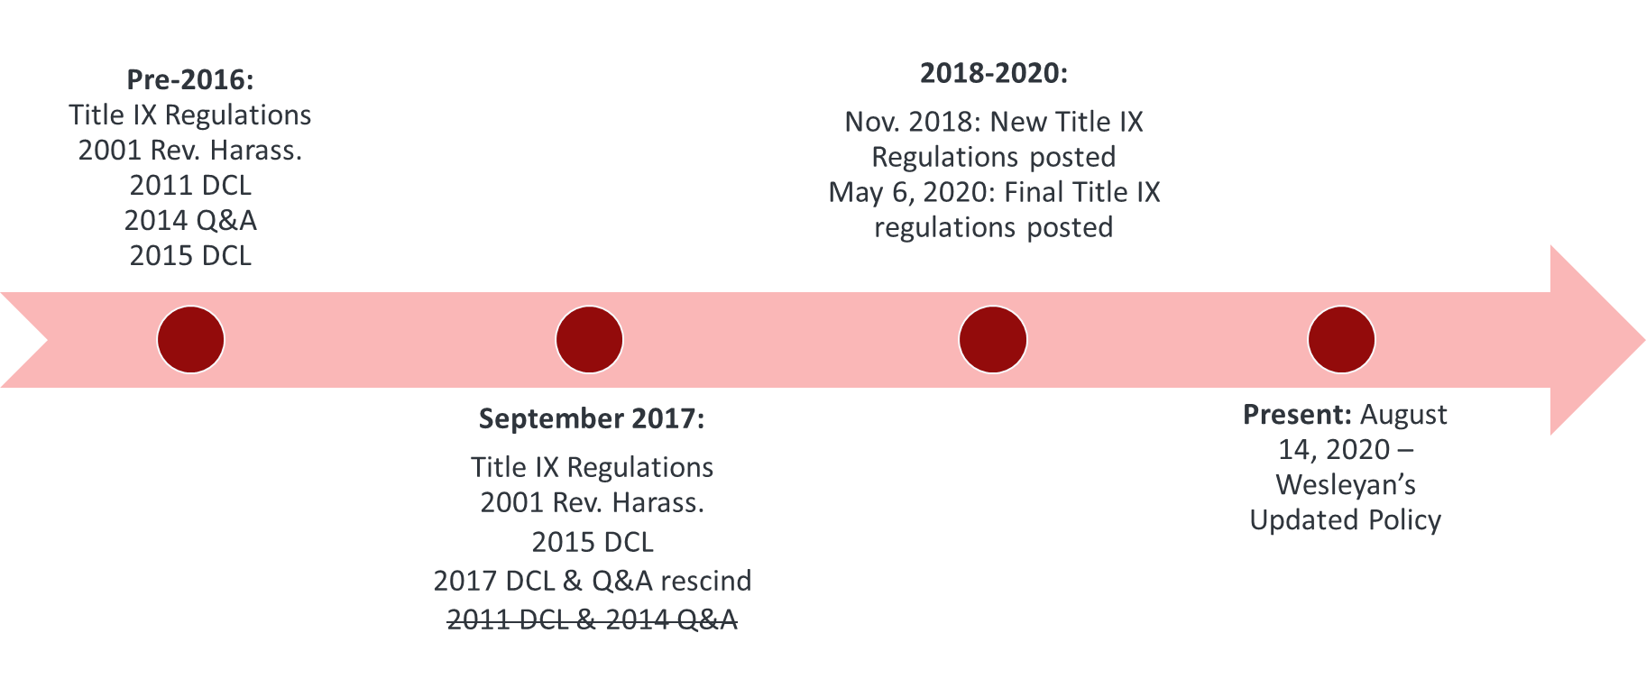
How Did We Get Here?

Slide 4

The Most Important Tools for You

Slide 5
Phase One: Initial Steps
Initial Steps Phase is not an investigation
Initial Contact with the Reporting Party
    Consideration of supportive measures and/or restrictions
    Discussion of the process
Early Decision Points
    Is dismissal appropriate, e.g., not alleging sexual misconduct?
    Does the Reporting Party wish to file a Formal Complaint?
    Does the Reporting Party desire some other informal resolution process other then the formal complaint process? (Formal Complaint still required, but process is different.)
    When does the Responding Party get brought in to the process?
    Many of these decisions are evolving; appropriate supportive measures may need updates. For example, a Party may not need any academic accommodations in the fall semester, but they may need them if the investigation carries into the spring and courses change

Slide 6
Supportive Measures
    Available to both parties, regardless of whether a formal complaint is filed
    Non-disciplinary and non-punitive
    No fee or charge may be applied to reasonable supportive measures
    Goal is to restore/preserve equal access without unreasonably burdening the other Party, e.g., no assumptions should be made about which party should be moved – focus on burden
    Confidential to the extent possible
    Considerations: specific needs of the parties; severity of the allegations; shared spaces, etc.
    Parties may be removed from campus on an emergency basis, but appeal process must be provided for emergency removals

Slide 7
Jurisdictional Issues
Who is a Reporting Party
    At the time of complaint must be currently participating in or attempting to participate in Wesleyan’s educational programs or activities
      Educational programs or activities are locations, events, or circumstances over which Wesleyan exercises substantial control
    Wesleyan may exercise discretion in signing complaints for others, e.g., Reporting Party’s from other schools that report allegations against Wesleyan students/employees
    No extraterritoriality requirement, i.e., no international reach
Conduct at Issue
    Sexual harassment, sexual assault, intimate partner violence, stalking, retaliation
    What about sexual exploitation and/or complicated forms of retaliation?
    Sexual harassment is used in regulations as a catch-all, but it is also a separate claim, i.e., hostile environment or quid pro quo theories. (Wait, what?)

Slide 8
Phase Two: The Investigation Phase
Notice to Both Parties
Designation of Investigator(s)
    At least one investigator, internal and/or external
    Qualified, trained on Wesleyan’s process, and without conflicts (parties may raise)
    Must conduct a prompt, fair, and impartial investigation
    Interview parties/witnesses, review evidence, draft an Investigative Report
Right to Advisors
    Both parties are entitled to a single advisor of choice, and may be an attorney
    Advisors may be present “during any formal disciplinary proceeding, including any related meeting, interview, or hearing”
    Advisor role is largely consistent with prior process, but they have added importance (and are necessary) during the live hearing process in the next phase

Slide 9
Phase Two: The Investigation Phase, cont.
Investigation Begins
    Investigators will interview the Reporting Party and Responding Party
    Investigators will interview additional relevant witnesses; collect relevant information
    Parties “have the opportunity (and are expected) to provide” potential witnesses/documents
      Note also the Duty of Honesty and the Duty of Cooperation in the Policy
    Culminates with Investigative Report: summary of the facts, inconsistencies, an optional section for credibility concerns, and all relevant evidence (inculpatory and exculpatory)
Investigative Report Review by the Parties
    Both Parties have the opportunity to review the Investigative Report (10 calendar days)
    Review strives to be highly secure: no copies, no photographs, if electronic or remote then appropriate protections put in place
    Advisors allowed to accompany Parties for review
    Both parties allowed to submit a response to correct errors, clarify statements, suggest additional information sources
    Investigator may investigate further, revise report, or decide neither step is necessary

Slide 10
Phase Two: The Investigation Phase, cont.
Additional Considerations
    Hearing process (Phase Three) is really important in the new Title IX regulations. If a Party or a witness refuses to sit for cross-examination, their evidence cannot be considered at hearing.
      What if the Reporting Party refuses to go to hearing? Responding Party?
    Responding Party can voluntarily agree to Policy violation prior to hearing
    Informal processes can be sought any time prior to convening a Determination Hearing
      Flexibility in options, but both parties must agree to informal process
      Title IX Coordinator must agree to informal process. Considerations: severity of the behavior, patterns of behavior and risk to the community
      An additional person will be asked to facilitate any informal process
      Either party can leave informal process and go back to formal process

Slide 11
Phase Three: The Adjudication and, if Necessary, Sanctioning Phase
Determination Officer
    Qualified, trained on Wesleyan’s process, and without conflicts (parties can raise)
    All parties and witnesses are expected to sit for examination
    Presides over the live hearing: controls process, controls timing, makes decisions about evidence relevance (or whether certain evidence is prohibited). Types of challenges?
      Sexual predisposition
      Prior sexual behavior (unless offered to prove someone else at fault or solely to prove consent)
      Otherwise privileged information, e.g., medical records for which there is no waiver
    Wesleyan has the burden of proof
    All decisions made using the preponderance of the evidence standard

Slide 12
Phase Three: The Adjudication and, if Necessary, Sanctioning Phase, cont.
Parties Must Have Advisors at the Live Hearing
    Advisors required at the live hearing to conduct witness examinations (may question all witnesses – where you may hear the term “cross-examination). If a Party does not have an advisor, Wesleyan will provide an advisor (not the Party’s choice)
    Advisors not otherwise allowed to participate actively
    Parties may consult with their advisee in a non-disruptive manner

Slide 13
Phase Three: The Adjudication and, if Necessary, Sanctioning Phase, cont.
Sanctions, if Necessary
    Only focused upon after a Party is found responsible are sanctions considered.
    Determination Officer assigns sanctions
    Determination Officer may request information from University on prior sanctions in similar matters.
    Purpose of requesting information is to understand sanctioning history in similar cases; may be challenging in cases without prior precedent
    Notice of Outcome
    Notice provided after decision made on responsibility and, if necessary, sanctioning
    Consists of a summary of the allegations and the determinations made by Determination Officer.
    Must include process for appeal
    Notice of outcome may also be shared within Wesleyan for people with legitimate education interest, e.g., administrators executing sanctions, athletic coaches, etc.

Slide 14
Phase Three: The Adjudication and, if Necessary, Sanctioning Phase, cont.
    Additional Considerations
    Hearings will be recorded
    Hearings may be virtual at request of parties (or a hybrid option)
    In person hearings may include parties physically present or separate but able to observe via technology in real time
    University retains discretion about Parties being in same physical space
    Disability-related accommodations should be considered for Parties and witnesses throughout process, as necessary.

Slide 15
Phase Four: Appeals
Appellate Officer
    Qualified, trained on Wesleyan’s process, and without conflicts (parties may raise)
Timing and Format
    Must be submitted in writing within five business days of final outcome letter
    Following submission of an appeal, the non-appealing party may give a limited response within three business days
    Extensions may be granted; if granted to one party, automatically afforded to the other Party
Grounds for Appeal
    Procedural error that materially prejudiced the outcome; and/or
    Newly discovered material information that was not known/available to the Investigator or the Determination Officer and which likely could have changed the finding of responsibility or sanction had it been available
    Bias or a conflict of interest regarding the Title IX Coordinator, the Investigator, or the Determination Officer

